Slide 1
CORE VALUES AT HIGHER SECONDARY LEVEL
MRS TARAWATI SHARMA
PGT BIOLOGY

Slide 2


Slide 3
Values are personal attitudes, judgments, and beliefs that guide thoughts, actions, and choices.
Purpose:
They provide a framework for understanding how to interact with others and influence behavior.
Core values provide a framework for making decisions and improving our self-worth.
By clarifying core values, we can develop a sense of purpose and make choices that are in harmony with your true self.

Slide 4
Core Values
Integrity
Compassion
Empathy
Tolarence
Honesty
Value education focuses on identifying and emphasizing core values that are essential for personal and social development.

Slide 5
CBSE Core Values
1. Integrity and Honesty
2. Respect for Diversity
3. Empathy and Compassion
4. Discipline and Responsibility
5. Environmental Awareness
6. Commitment to Excellence

Slide 6
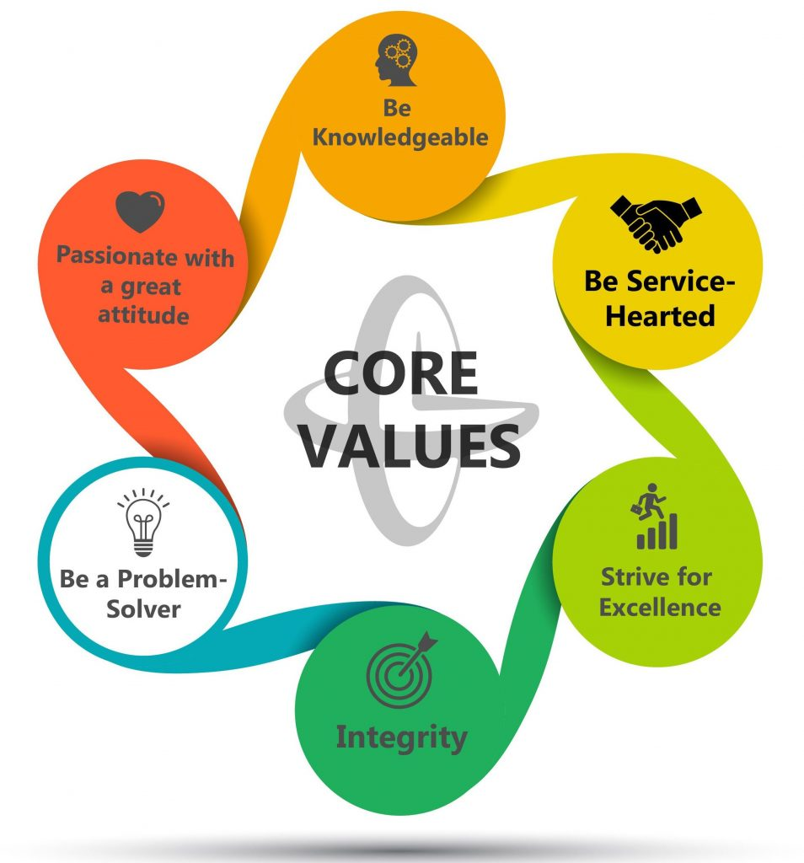

Slide 7
Role of Teachers and Parents:
Teachers and parents play crucial roles in value education. They serve as role models, guiding and reinforcing values through their own actions and interactions with individuals. They facilitate discussions, provide guidance, and create a supportive environment for value-based learning.

Slide 8
The Role of Teachers and the School
Teacher as a Role Model: Teachers are central figures who must embody the values they teach.
Shared Values Language: Establish a common vocabulary for values across the school.
Consistent Reinforcement: Values should be consistently reinforced through all aspects of school life.
Collaboration: Involve parents and the community in values education efforts.

Slide 9
Why Values Education is Crucial in Secondary School
Holistic Development: Fosters moral, social, and cultural growth, creating well-rounded individuals.
Building Character: Develops strong character and a sense of ethics.
Societal Harmony: Promotes tolerance, cooperation, and a positive environment within the school and community.
Global Citizenship: Prepares students to be active and responsible members of a complex world.

Slide 10
Direct Methods:
Moral Storytelling: Using narratives about great individuals to illustrate good qualities.
Morning Assembly: Thought for the day or sharing inspirational quotes.
Dedicated Classes: "Moral science" classes for focused value instruction.
Indirect Methods:
Integrate into Subjects: Incorporate values into literature, history, geography, and science lessons.
Co-curricular Activities: Use drama, clubs, and community projects to build values.
Role Modeling: Teachers act as intellectual and moral role models for students

Slide 11


Slide 12


Slide 13
How it helps???
To probe the inner urge of the students.
To encourage and enhance the skill of the students.
To inculcate traditional cultural and human values.
To make aware of using information and communication technology.
To urge for competency.
To eye on the strength, infirmities, opportunities, and challenges.
To inculcate the moral and the ethical values among the students.

Slide 14


Slide 15


Slide 16


Slide 17
Core values shape character and national identity.
CBSE aims to produce learners who are:
• Academically proficient
• Ethically strong
• Socially responsible
“Values are caught, not taught.”

Slide 18
Presented by:
Tarawati Sharma
Army Public School, Nasirabad
“Education is not just about learning facts but about learning values.”

Slide 19


